Slide 1

Stock Price Prediction Using LSTM Neural Network
Ayush Behera
03323802722

Slide 2

Problem Statement
The project's objective is to construct a machine learning model for predicting future stock prices using a Long Short-Term Memory (LSTM) neural network. LSTMs, a form of Recurrent Neural Network (RNN), are suitable for time series data due to their ability to retain patterns over extended sequences. This model will process historical stock price data to generate predictions that can guide investment decisions. Stock markets are inherently volatile, influenced by many dynamic factors, and accurate price prediction is challenging due to their stochastic nature. Traditional statistical models often struggle with nonlinear patterns, whereas deep learning approaches like LSTMs can effectively learn complex temporal dependencies in data.

Slide 3
Objectives
The main objective is to develop a stock price prediction system using LSTM neural networks and make it accessible, interactive, and practical through a Streamlit web application.
Specifically, the objectives are:
Learn from historical price trends. Predict future stock prices with improved accuracy.
Build a next‑day price forecast for selected tickers with a clear scope and limits.
Deliver Interactive Visualization & App Development with an intuitive Streamlit UX: simple controls, and interactive charts.
Communicate uncertainty (confidence cues/bands) and interpretation.
Performance Analysis and Validation

Slide 4
Dataset
Source: Yahoo Finance via yfinance Python library. Provides historical stock market data for any ticker (e.g., AAPL, TSLA, GOOG)
Key terminologies:
Date: Trading date (daily, weekly, or chosen interval)
Open: first traded price of the session at the chosen interval.
High: highest traded price during the session/interval.
Low: lowest traded price during the session/interval.
Close: last traded price of the session/interval.
Volume: shares traded during the session/interval.
Adjusted Close: Close adjusted for dividends/splits to maintain continuity for backtests and return series.

Slide 5

THE
SOLUTION
Data Collection
Preprocessing and Cleaning
Training LSTM Model
Testing
Streamlit App

Slide 6
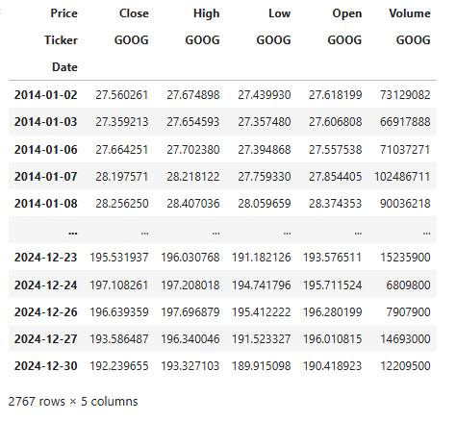
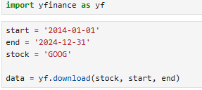
Data Collection
Source: Yahoo Finance via the Python yfinance library, returning OHLCV price series for chosen tickers and dates. Provides free and reliable access to historical market data
Import yfinance in Python
Use yf.download(ticker, start, end) to fetch data
We used Google’s data for the model training and testing.

Slide 7
Data Preprocessing and Cleaning
Why Preprocessing? Stock data is raw and noisy and models require normalized, structured input for better learning.
Steps in Preprocessing:
1. Check for null/NaN values. Drop or interpolate missing rows
2. Focus on Close Price (target variable)
3. Train–Test Split. 80% training data and 20% testing data
4. Normalization. Apply MinMaxScaler; scale prices to range [0,1]. Ensures stable LSTM training

Slide 8
Training LSTM Model
Model Architecture:
Sequential Model built using Keras
Layers:
LSTM Layer(s): captures time dependencies in stock prices
Dropout Layer(s): prevents overfitting
Dense Layer: fully connected layer to output prediction (1 value: next-day price)
Optimizer: Adam (efficient gradient descent)
Loss Function: Mean Squared Error (MSE)
Hyperparameters:
Epochs = 50
Batch size = 32
Input shape = (100 timesteps, 1 feature)

Slide 9
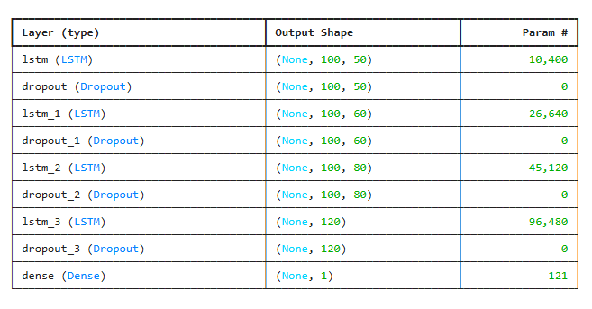
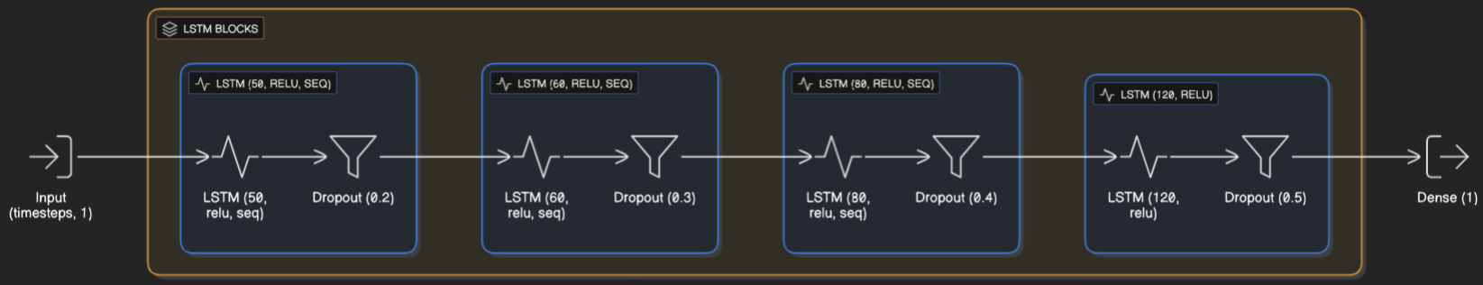
Training LSTM Model (cont.)
Process: 1. Feed sequences of 100 past days (x) to predict next day price (y) 2. Model weights updated using backpropagation through time

Slide 10
Testing
Process: 1. Combine last 100 days of training data with test data for continuity. Normalize using same MinMaxScaler 2. For each day in test set, take previous 100 days as input (x). True next-day price is output (y) 3. Model predicts next-day stock prices from test sequences. Rescale predictions back to actual values 4. Predictions follow actual stock price trends closely. Enables visualization of Predicted vs Actual performance on test dataset.
This phase ensures that the trained model is generalized and performs well on unseen stock data.

Slide 11
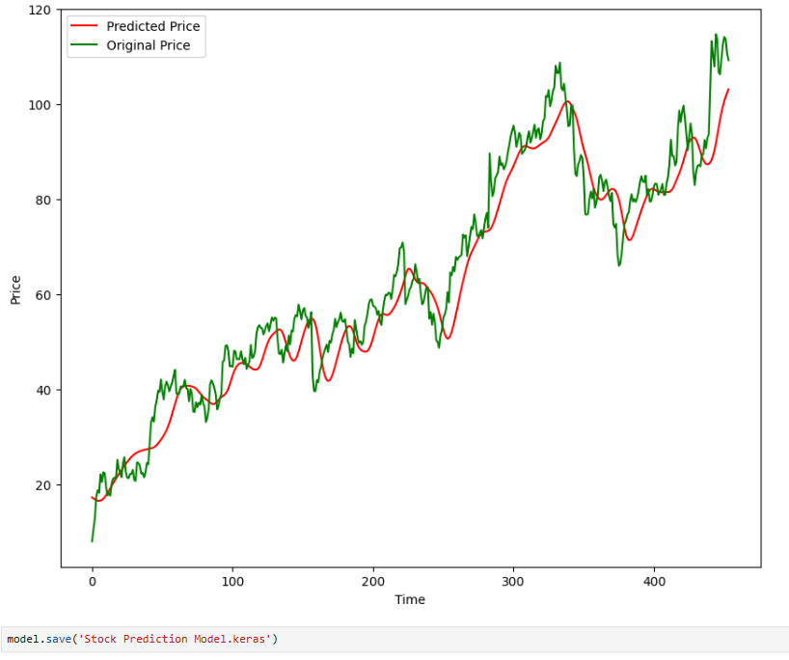

Slide 12
Streamlit App
The app is a lightweight Streamlit front end that wraps the trained model to fetch data, run inference, and render KPIs and charts interactively. Streamlit reruns the script on each interaction, so the design uses per-session state to keep selections/results consistent across reruns.
Stock Settings:
Dropdown to select stock ticker (e.g., NVDA, GOOG, TSLA, AAPL etc.)
Option to manually enter a symbol
Start date input for historical data retrieval

Slide 13
Price History:
Company details: name, sector, data points
Current price display with real-time change indicator
Interactive price history chart (zoomable, time-based trends) i.e., a long‑range price history chart for quick situational awareness.
Model Performance:
Key Performance Indicators (KPIs) are derived from the same dataset powering the model inputs. They are as follows:
R² Score for accuracy
MAE (Mean Absolute Error) for error measure
Model rating indicator (e.g., Good,)

Slide 14
Prediction vs. Actual:
Compares model predictions with realized closes on a time‑aligned plot, alongside headline metrics (e.g., R² and MAE) to communicate fit quality.
Clear comparison using line charts (LSTM predictions). Helps evaluate prediction reliability and trend following
Next-day prediction:
Displays current closing price,
Next-day closing price forecast with confidence level
Lookback period parameter (days of past data used)
Volumes Traded:
Volume analysis chart with 7-day SMA overlay
Highlights liquidity and trading activity trends

Slide 15
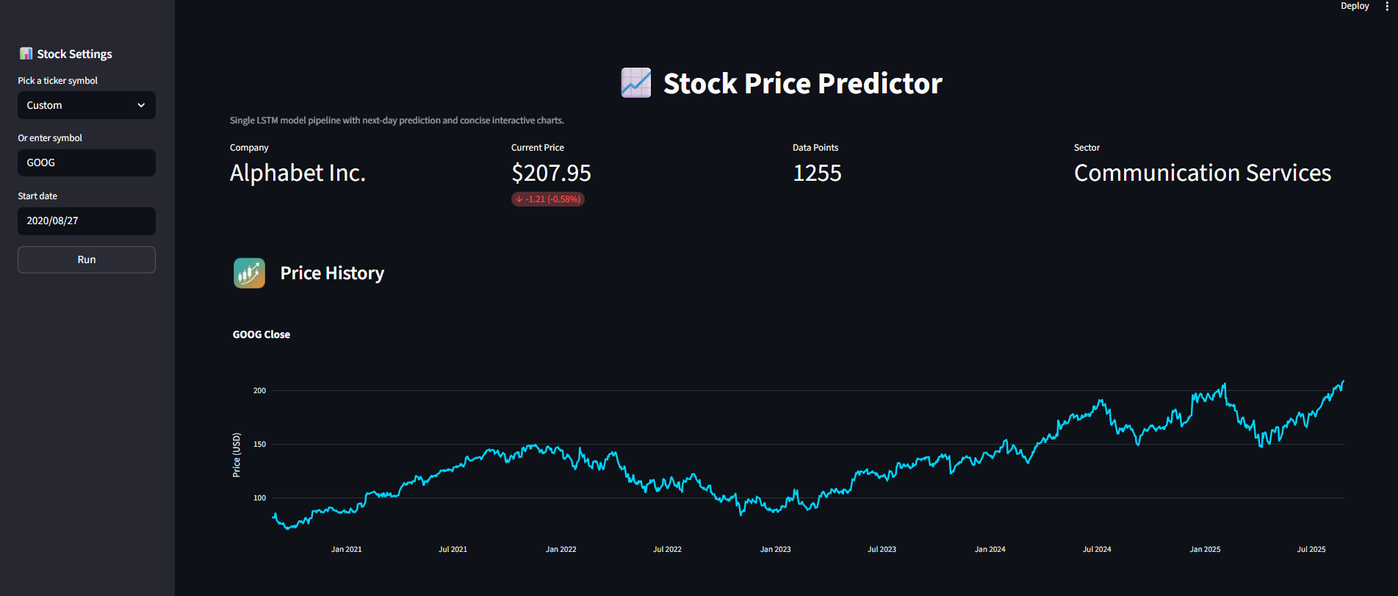
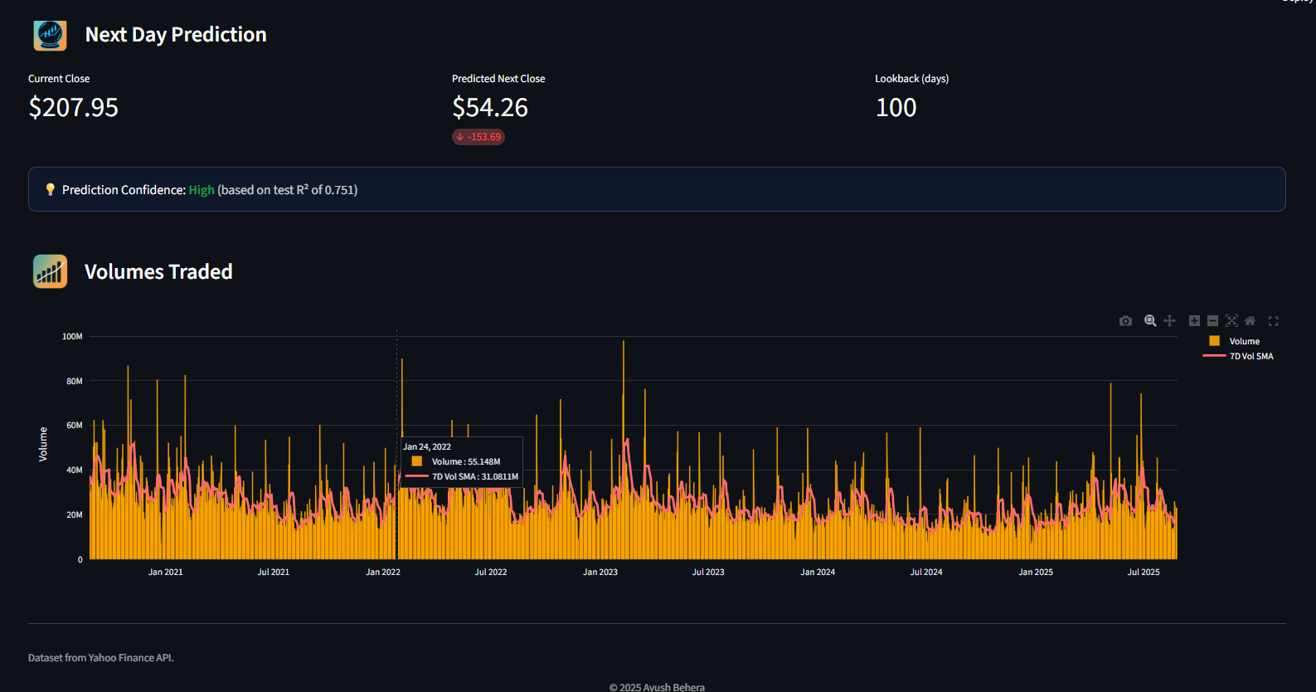
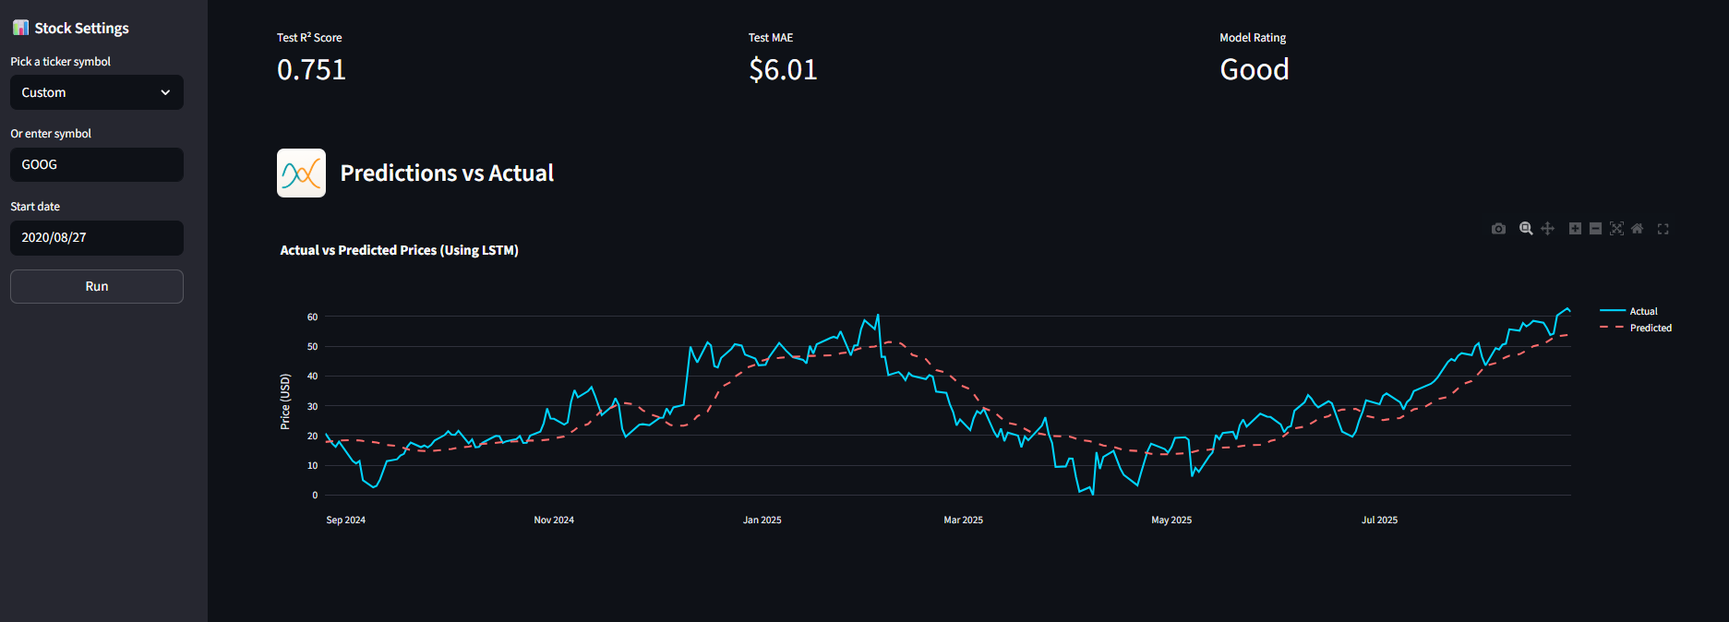
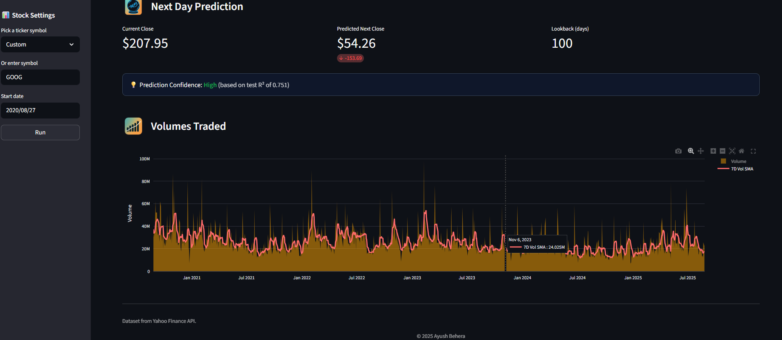
Preview of Streamlit App

Slide 16


